Slide 1

EVALUATE · TRAIN · BUILD
The Art of
Evaluating candidates
[ 30 MIN ]
Training interviewers
[ 30 MIN ]
Building the process
[ 30 MIN ]
Hiring
Notes:
Philosophy, content and process borrowed heavily from TellApart, Twitter, Wade Chambers, and "Who: The A Method for Hiring". Three arcs, about 30 minutes each.

Slide 2

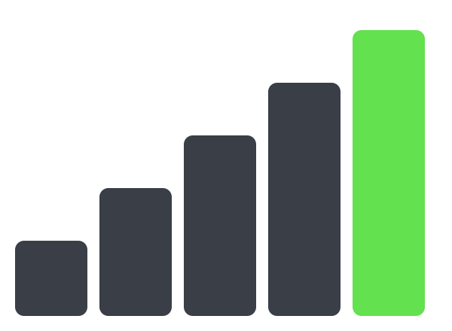
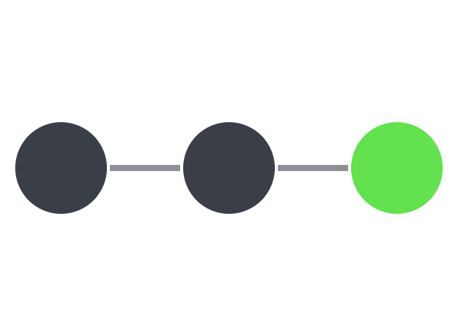
Every company interviews.
Few train their interviewers.
[ THE WHOLE TALK ]
01 · EVALUATE
02 · TRAIN
03 · BUILD
Strength × Fit
Five levels
3-stage process
Who should we hire?
What makes an interviewer great?
How do we run it?
Copyright Dobromir Montauk, 2026
[ 2 ]
Notes:
The whole talk on one slide. Arc 1: how we evaluate candidates, on two axes: Strength and Fit. Arc 2: how we train interviewers, through five levels from Competence to Landing. Arc 3: how we build the process, in three stages: getting to the interview, the interview, the close. Philosophy, content and process borrowed heavily from TellApart, Twitter, Wade Chambers, and "Who: The A Method for Hiring".

Slide 3
[ ARC 2 · TRAINING INTERVIEWERS ]
Your job: build
the hiring machine.
As an EM, that means training your interviewers.
Copyright Dobromir Montauk, 2026
[ 3 ]
Notes:
Your job as an Engineering Manager is to BUILD the hiring process, which requires training your interviewers. Arc 1 was who to hire. Arc 2 is how each interviewer gets great at finding and landing them.

Slide 4

Five levels of an A-player interviewer.
[ TRAINING INTERVIEWERS ]
L5
Landing
L4
Magnet
“I joined to work with you.”
L3
Fit
Strength attracts strength.
L2
Potential
What unlocks them here?
L1
Competence
How far can they grow?
Do they meet our bar?
Copyright Dobromir Montauk, 2026
[ 4 ]
Notes:
The five levels: Competence, Potential, Fit, Magnet, Landing. Each one is more complex to master (skill and process) and more valuable to the company. Most interviewers live at L1. The goal is an interviewer who works all five.

Slide 5
How the levels work.
[ TRAINING INTERVIEWERS ]
01
02
03
04
05
Builds on the last
Start anywhere
Harder each step
Taught on its own
Overlays the loop
Higher levels build on lower ones.
You don't need to master a level before working on the next.
Difficulty of mastery rises with each level.
Each level is trained independently.
Every stage of the interview process uses them.
Copyright Dobromir Montauk, 2026
[ 5 ]
Notes:
Higher levels build on lower levels. Mastery of a lower level is not required to start working on higher levels. Difficulty in mastery increases with level. Each level is taught independently. And the levels overlay the interview process: every stage uses them.

Slide 6

Do they meet our technical bar?
[ L1 · COMPETENCE ]
Applied intelligence + technical competence.
GOOD
Finds valuable strengths using standard questions or problems.
BETTER
Changes style to fit the candidate: standard questions, interactive problem solving, or their past work.
BEST
Makes it look easy.
L1
L2
L3
L4
L5
Copyright Dobromir Montauk, 2026
[ 6 ]
Notes:
L1, Competence. Question: do they meet our technical bar? Two things: applied intelligence and technical competence. Good: able to find valuable strength(s) using standard questions/problems. Better: able to change styles based on the candidate (standard questions vs. interactive problem solving vs. interviewing using their past). Best: make it look easy. It gets much harder to evaluate at higher levels of seniority.

Slide 7
Senior isn’t “knows what I know.”
[ L1 · COMPETENCE ]
WRONG BAR
RIGHT BAR
“Do they know what I know?”
“What should they know, given their path?”
Knowledge comes from experience. Yours and theirs aren’t comparable.
Read the résumé, then test what that experience should have taught them.
LOOK FOR
Judgment
Good questions
Improvisation
Copyright Dobromir Montauk, 2026
[ 7 ]
Notes:
How do you determine senior level? It is not "do they know what I know": knowledge is based on experience, so it is not directly comparable. You need to understand what they SHOULD know based on their résumé and experience. Look for judgment, good questions, improvisation. [Clip from The Matrix: TBD.]

Slide 8

What is their potential?
[ L2 · POTENTIAL ]
Interviewing for potential, not just today’s skill.
GOOD
Finds repeated examples of high-potential behavior.
BETTER
Finds the limits: what are their blind spots?
BEST
Knows whether what unlocks their potential exists here.
L1
L2
L3
L4
L5
Copyright Dobromir Montauk, 2026
[ 9 ]
Notes:
L2, Potential. Good: able to find repeated examples of high-potential behaviors (motivation, curiosity, insight, engagement, determination). Better: able to determine limitations in those behaviors: what are their blind spots? Best: able to correctly determine whether the things necessary to unlock their potential exist here. That last one is the bridge to L3.

Slide 9
What does potential look like?
[ L2 · POTENTIAL ]
01
02
03
04
05
Motivation
Curiosity
Insight
Engagement
True Grit
A fierce commitment to excel in pursuit of unselfish goals.
Seeks new experiences, knowledge and candid feedback, to grow.
Gathers and makes sense of information that suggests new possibilities.
Uses emotion and logic to communicate a persuasive vision and connect.
Fights for difficult goals and bounces back from adversity.
Copyright Dobromir Montauk, 2026
[ 8 ]
Notes:
Five high-potential traits. Motivation: a fierce commitment to excel in the pursuit of unselfish goals. Curiosity: seeks new experiences, knowledge, and candid feedback, with a focus on growing. Insight: the ability to gather and make sense of information that suggests new possibilities. Engagement: a knack for using emotion and logic to communicate a persuasive vision and connect with people. Determination: the wherewithal to fight for difficult goals despite challenges, and to bounce back from adversity. (These five come from Claudio Fernández-Aráoz, "21st-Century Talent Spotting", HBR 2014.)

Slide 10
How do you test potential in a technical interview?
[ L2 · POTENTIAL ]
Ask the room. Capture answers live.
?
?
?
Copyright Dobromir Montauk, 2026
[ 10 ]
Notes:
Open question to the room: how do you test for potential inside a technical interview? Capture answers live, on the slide or a whiteboard.

Slide 11

What unlocks their potential HERE?
[ L3 · FIT ]
A mix of alignment, role requirements and cultural fit.
GOOD
Understands their goals, the environment they need and any culture issues, and believes all three work here.
BETTER
Can lay out a plan (projects, timing) that would unlock their potential here.
BEST
Shows how similar people executed that plan and got the results here.
L1
L2
L3
L4
L5
Copyright Dobromir Montauk, 2026
[ 11 ]
Notes:
L3, Fit. What unlocks their potential HERE? It's a mix of alignment, role requirements and cultural fit. Good: understand their goals and believe they can achieve them here; understand the environment needed to unlock their potential and believe it exists here; understand cultural fit issues here. Better: able to create a plan (projects and timing) that would unlock their potential here. Best: able to show how a similar candidate's execution against that plan resulted in the desired performance here.

Slide 12
Your problem is their opportunity.
[ L3 · FIT ]
FIRES FORGE PEOPLE
BELIEVE IN THEM
BE CONCRETE
The hard team can be the growth role.
Maybe no one ever did.
Training starts in the interview.
Explain why the job will be hard, and why THEY will succeed.
Show them the fire, eyes open. Wrong people run away; the right ones get excited.
Give feedback, show our onboarding process, discuss how they would solve our problems.
Copyright Dobromir Montauk, 2026
[ 12 ]
Notes:
Fit: your problem is their opportunity. Fires forge people: a team in trouble can be the best place to grow. Show them the fire with eyes open; the wrong people run away, the right ones get excited. Believe in them: maybe no one ever did. Explain why the job will be hard, and why THEY will succeed. Be concrete: training starts during the interview. Give feedback, show our onboarding process, and discuss how they would solve our problems.

Slide 13

How do you attract talent?
[ L4 · MAGNET ]
Pro tip: you don’t sell them.
GOOD
Shows agility and depth in areas the candidate values. Strength attracts strength.
BETTER
Impresses them: clearly better, without threat, where they want to grow.
BEST
Shows how you personally can grow them, in a way they value.
L1
L2
L3
L4
L5
(No humble brags: be comfortable in your strengths and honest in your weaknesses.)
Copyright Dobromir Montauk, 2026
[ 13 ]
Notes:
L4, Magnet. How do you attract talent? Pro tip: you don't sell them. Good: able to demonstrate agility and depth in areas the candidate values (strength attracts strength). Better: able to impress the candidate: clearly better, in a non-threatening way, in key areas where the candidate wants to grow. Best: able to demonstrate how you personally can grow the candidate in a way the candidate values ("we can grow you"). No humble brags: be comfortable in your strengths and honest in your weaknesses.

Slide 14
Strength attracts strength.
[ L4 · MAGNET ]
A PLAYERS
Want to work for leaders stronger than themselves.
B PLAYERS
Feel uncomfortable around A players.
C PLAYERS
Can’t tell the difference between an A and a C.
Copyright Dobromir Montauk, 2026
[ 14 ]
Notes:
Strength attracts strength. Leaders want to work for leaders stronger than themselves. You know you have B players when they feel uncomfortable with A players. You know you have C players when they can't tell the difference between A and C players. Your interviewers ARE the pitch.

Slide 15

How do you land 10× talent?
[ L5 · LANDING ]
If it’s about the compensation, you’ve already lost.
GOOD
Connects with the candidate deeply, in a way that matters to them.
BETTER
Pitches the role, team and company with emotional impact.
BEST
Shows why they would win here vs. other options, and it resonates.
L1
L2
L3
L4
L5
(We only live once & work is a LOT of hours — show them your AWESOME self)
Copyright Dobromir Montauk, 2026
[ 15 ]
Notes:
L5, Landing. How do you land 10x talent? If it's about the compensation, you've already lost. Good: able to deeply connect with the candidate in a way that is meaningful to them. Better: able to pitch the value of the role/team/org/company in a way that has emotional impact. Best: able to show them why they would win here vs. other options, and have it resonate. We only live once, and work is a LOT of hours: show them your AWESOME self.

Slide 16
“I joined this company
to work with you.”
When you start hearing this, you’re at L5.
People decide with emotion, then find the reasons. Emotion is high-order computation.
Copyright Dobromir Montauk, 2026
[ 16 ]
Notes:
When you start hearing "I joined this company to work with you", you are at L5. People ultimately make decisions for emotional reasons, and come up with the rational ones to back them up. That's not a bad thing: emotion is very high-order computation. So tap into it. Show them you understand what pulls on their heartstrings, and why, by joining us, this won't be a JOB.

Slide 17

All five: an A-player interviewer.
[ TRAINING INTERVIEWERS ]
L1
Competence · Do they meet our bar?
L2
Potential · How far can they grow?
L3
Fit · What unlocks them here?
L4
Magnet · Strength attracts strength.
L5
Landing · “I joined to work with you.”
L1
L2
L3
L4
L5
Copyright Dobromir Montauk, 2026
[ 17 ]
Notes:
Put together, the five levels make an A-player interviewer. Next: three rules that make every level work.

Slide 18
Be interested.
[ RULE #1 ]
RESPONSIBILITY
LOOK FOR
EMPLOY
Connection
No distractions
Motivation
Pride
Why they left
Active listening
“Tell me more?”
(Turn off Slack and Claude!)
Copyright Dobromir Montauk, 2026
[ 18 ]
Notes:
Rule #1: be interested. Take responsibility for being interested: create connection, leave distractions outside the room (turn off Slack and Claude!), lower barriers to effective communication, make the candidate want to expand on details. Look for: what motivates them, what demotivates them, excitement and interest points, fear and pain points, their level of technical, personal and social skill, what they are proud of, why they took a role, why they left it. Employ active listening and curiosity: "what?", "how?", "tell me more?"

Slide 19
Be an advocate.
[ RULE #2 ]
GOOD FOR US
BAD FOR US
Fit is established jointly.
Great employee.
They get fired when we figure it out.
FOR THEM
GOOD FOR THEM
Is this the right next stage of their career? What do they want, and how will they prioritize?
They leave when they figure it out, or stay for the wrong reason.
Nobody wins.
DON’T GO NATIVE
BAD FOR THEM
You represent the company. Every candidate leaves an evangelist.
Copyright Dobromir Montauk, 2026
[ 19 ]
Notes:
Rule #2: be an advocate. Fit needs to be jointly established. Good for them and good for us: great employee. Good for us, bad for them: they leave when they figure it out, or stay for the wrong reason. Good for them, bad for us: they get fired when we figure it out. For them: is this a good place for the next stage of their career? What are they looking for? How will they prioritize? Do they have clarity on what they want and need? Within reason, help them figure out fit ("this could mean this or that, which did you mean?", "here is what I learned about you"). Don't set them up for failure. Don't go native: remember you represent the company. We always want candidates to leave as company evangelists. For us: is this an A player?

Slide 20
Be someone they want to work with.
[ RULE #3 ]
Park your ego
Be genuine
Be aware
Be a gracious host
Be excited
Be interested
Be wicked smart
Ask insightful questions
Ask hard questions
Be helpful
They’re interviewing you, too.
Copyright Dobromir Montauk, 2026
[ 20 ]
Notes:
Rule #3: be someone they want to work with. Park your ego. Be genuine. Be aware. Be a gracious host. Be excited. Be interested. Be wicked smart. Ask insightful questions. Ask hard questions. Be helpful.

Slide 21
Five levels, how to do each.
[ ARC 2 RECAP ]
L1
Competence
Adapt to the candidate: standard questions, live problems, or their past work.
L2
Potential
Find repeated high-potential behavior, then probe for the blind spots.
L3
Fit
Lay out the plan, projects and timing, that unlocks them here.
L4
Magnet
Interview on the real work, and show how you’ll grow them.
L5
Landing
Find what moves them, and show them the path ahead.
Copyright Dobromir Montauk, 2026
[ 25 ]
Notes:
Recap: the five levels, and how to do each. L1 Competence: Adapt to the candidate: standard questions, live problems, or their past work. L2 Potential: Find repeated high-potential behavior, then probe for the blind spots. L3 Fit: Lay out the plan, projects and timing, that unlocks them here. L4 Magnet: Interview on the real work, and show how you’ll grow them. L5 Landing: Find what moves them, and show them the path ahead. Next, Arc 3: building the process.

